Slide 1
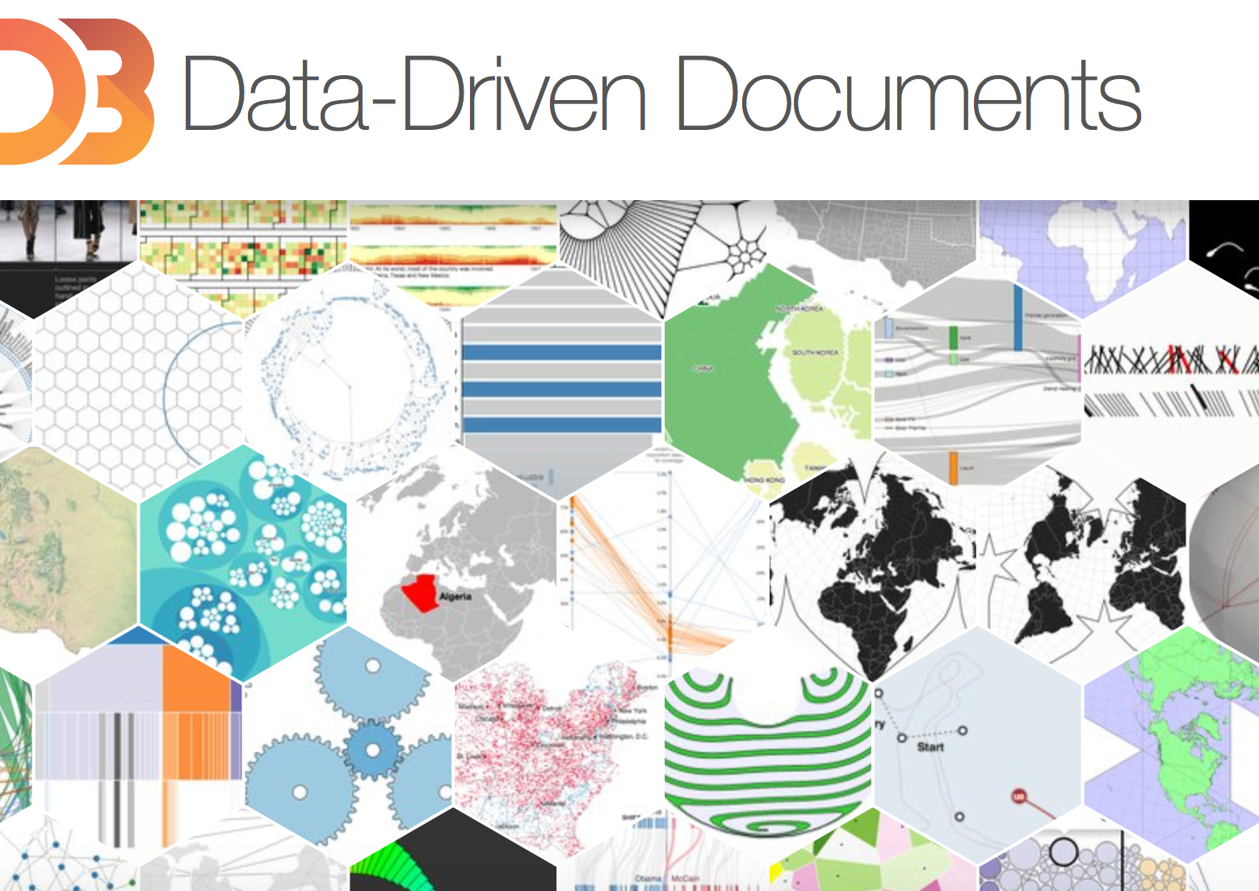
MassMutual DSDP 2017: Introduction to d3
June 12, 2017
R. Jordan Crouser & Amelia McNamara
Statistical & Data Sciences
Smith College

Slide 2
D3.js
JavaScript library designed to make web-based visualization easier
Data transformation, rather than new representation
Visualization problems reduced to constructing and updating a DOM
DOM responds to changes in underlying data (stream or interaction)
Much of what follows comes from Mike Bostock's VIZBI 2012 workshop

Slide 3
Why use D3?
Uses existing web standards (HTML and SVG)
SVG visual primitives: rect, circle, path, etc.
Low point of entry
Future-proofing
Compatibility with existing tools (like CSS and debuggers)
Use what you already know!
Use the browser's JavaScript console to debug interactively

Slide 4
Selections
D3’s atomic operand (much like jQuery)
d3.selectAll("circle") // return all elements with // the circle tag
Can select by any facet:
#foo // <any id="foo">
foo // <foo>
.foo // <any class="foo">
[foo=bar] // <any foo="bar">
foo bar // <foo><bar></foo>
Result is an array of elements that match description

Slide 5
Selection example
// Select all <circle> elements
var circle = d3.selectAll("circle");
// Set some attributes and styles
circle.attr("cx", 20); // Center x value = 20
circle.attr("cy", 12); // Center y value = 12
circle.attr("r", 24); // radius = 24px
circle.style("fill", "red");

Slide 6
Selection example
Method chaining allows shorter (and more readable) code
// Select all <circle> elements
// and set some attributes and styles
d3.selectAll("circle")
.attr("cx", 20)
.attr("cy", 12)
.attr("r", 24)
.style("fill", "red");

Slide 7
Selection.append
To build dynamic visualizations, we need to be able to add new elements as well
var h1 = d3.selectAll("section")
.style("background", "steelblue")
.append("h1")
.text("Hello!");
Use caution with method chaining: append returns a new selection!

Slide 8
Mapping data to elements
Data are arrays
Could be numbers:
var data = [1, 1, 2, 3, 5, 8];
Or objects:
var data = [
{x: 10.0, y: 9.14},
{x: 8.0, y: 8.14},
{x: 13.0, y: 8.74}
];
D3 provides a pattern for managing the mapping from data to elements: enter(), update(), exit()

Slide 9
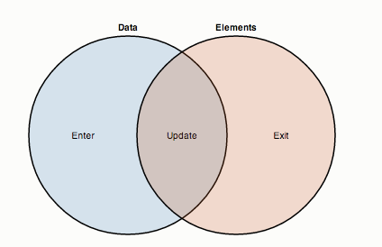
Thinking with joins (in 60 seconds)
.enter() figure out what’s changed in the dataset
.update() assign data items to visual elements
.exit() delete items no longer being displayed

Slide 10
D3 example
svg.selectAll("circle")
.data(data)
.enter().append("circle")
.attr("cx", x)
.attr("cy", y)
.attr("r", 2.5);
The first line may be surprising: why select <circle> elements that don’t exist yet?
=>You’re telling D3 that you want circles to correspond to data elements

Slide 11
D3 example (breakdown)
var circle = svg.selectAll("circle")
.data(data); // Data method computes the join, // defining enter() and exit()
// Appending to the enter selection
// creates the missing elements
circle.enter().append("circle")
.attr("cx", x(d) {
return d.x; // New elements are bound to }) // data, so we can compute
.attr("cy", y(d) { // attributes using accessor
return d.y; // functions
})
.attr("r", 2.5);

Slide 12
Working with external data
CSV: d3.csv()
JSON: d3.json()
Data loaded asynchronously (browser won't stall)
Everything is returned as an array => JavaScript's built in array functions work:
array.{filter,map,sort,…}
Additional data-transform methods; explore the API
d3.{nest,keys,values,…}

Slide 13
Scales
Map from data space to visual space
20 75
0 100

Slide 14
Ordinal scales
Map a discrete domain to a discrete range
Essentially an explicit mapping
var x = d3.scaleOrdinal()
.domain(["A", "B", "C", "D"])
.range([0, 10, 20, 30]);
x("B"); // 10
Often used to assign categorical colors
d3.scaleOrdinal()
.range(d3.schemeCategory10)
Predefined range
(perceptually sound)
Notes:
d3.schemeCategory10

Slide 15
Quantitative scales
Map a continuous (numeric) domain to a continuous range
var x = d3.scaleLinear() // Others include scaleSqrt(), .domain([12, 24]) // scaleLog(), etc.
.range([0, 720]);
x(16); // 240
Typically, domains are derived from data:
.domain([0, d3.max(numbers)])
or
.domain(d3.extent(numbers)) // To compute min/max
// simultaneously
Need a compound (“polylinear”) scale? No problem: the domain and range can have more than two values!

Slide 16
Line (and Area) Generators
Can use scales to generate lines and regions
var x = d3.scale.linear(),
y = d3.scale.linear();
var line = d3.svg.line() // Line generator
.x(function(d) { return x(d.x); })
.y(function(d) { return y(d.y); });
svg.append("path") // Pass data to the line generator
.datum(objects)
.attr("class", "line")
.attr("d", line);

Slide 17
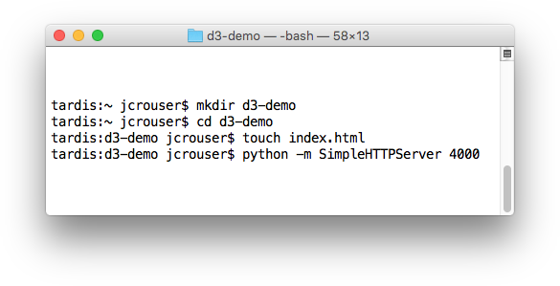
Let’s play!
Create a new directory
Create an empty index.html file inside the directory
Start up a little web server

Slide 18
Our data

Slide 19
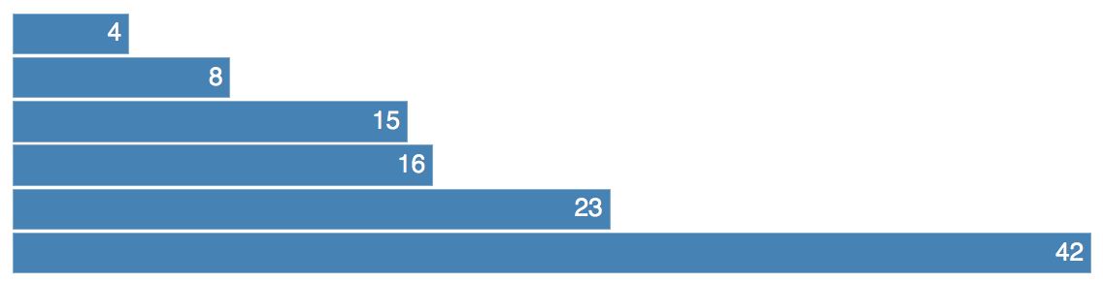
Our goal

Slide 20
Attempt #1: pure HTML
<div class="chart">
<div style="width: 40px;">4</div>
<div style="width: 80px;">8</div>
<div style="width: 150px;">15</div>
<div style="width: 160px;">16</div>
<div style="width: 230px;">23</div>
<div style="width: 420px;">42</div>
</div>
<style>
.chart div {
font: 10px sans-serif;
background-color: steelblue;
text-align: right;
padding: 3px;
margin: 1px;
color: white;}
</style>

Slide 21
Attempt #2: with d3.js (setup)
<div class="chart"></div>
<style>
.chart div {
font: 10px sans-serif;
background-color: steelblue;
text-align: right;
padding: 3px;
margin: 1px;
color: white;}
</style>
<script src="https://d3js.org/d3.v4.min.js"></script>

Slide 22
Attempt #2: with d3.js
<script>
var data = [4, 8, 15, 16, 23, 42];
d3.select(".chart") // Select the container
.selectAll("div") // Select the elements we want to bind
.data(data) // Bind the data to the selection
.enter()
.append("div") // Append/style new elements
.style("width",
function(d) {return d * 10 + "px"; })
.text(function(d) { return d; });
</script>

Slide 23
Attempt #3: with d3.js and scales
<script>
var data = [4, 8, 15, 16, 23, 42];
var x = d3.scaleLinear()
.domain([0, d3.max(data)])
.range([0, 430]);
d3.select(".chart") // Select the container
.selectAll("div") // Select the elements we want to bind
.data(data) // Bind the data to the selection
.enter()
.append("div") // Append/style new elements
.style("width",
function(d) {return x(d) + "px";})
.text(function(d) { return d; });
</script>

Slide 24
Attempt #4: with d3.js and SVG (setup)
<svg class="chart"></svg>
<style>
.chart rect {
fill: steelblue;}
.chart text {
fill: white;
font: 10px sans-serif;
text-anchor: end;}
</style>
<script src="https://d3js.org/d3.v4.min.js"></script>

Slide 25
Attempt #4: with d3.js and SVG (setup)
<script>
var data = [4, 8, 15, 16, 23, 42];
var width = 420,
barHeight = 20;
var x = d3.scaleLinear()
.domain([0, d3.max(data)])
.range([0, width]);
var chart = d3.select(".chart")
.attr("width", width)
.attr("height", barHeight * data.length);

Slide 26
Attempt #4: with d3.js and SVG (setup)
var bar = chart.selectAll("g")
.data(data)
.enter().append("g")
.attr("transform", function(d, i) {
return "translate(0,"+i*barHeight+")";});
bar.append("rect")
.attr("width", x)
.attr("height", barHeight - 1);
bar.append("text")
.attr("x", function(d) { return x(d) - 3; })
.attr("y", barHeight / 2)
.attr("dy", ".35em")
.text(function(d) { return d; });
</script>

Slide 27

Discussion
What are some of D3’s strengths? Weaknesses?
What are some of R’s strengths? Weaknesses?

